Slide 1
Homework 1
Francisco Caetano
Simulation of Complex systems

Slide 2
Exercise 1
Random walk performed by a single agent
d=1
Modelling disease spreading on a square lattice with small dimensions
N=40
20x20-lattice
d=0.8; β=0.6; γ=0.01
Modelling disease spreading for 1000 agents on a 100x100–lattice
d=0.8; β=0.6; γ=0.01

Slide 3
Random Walk

Slide 4
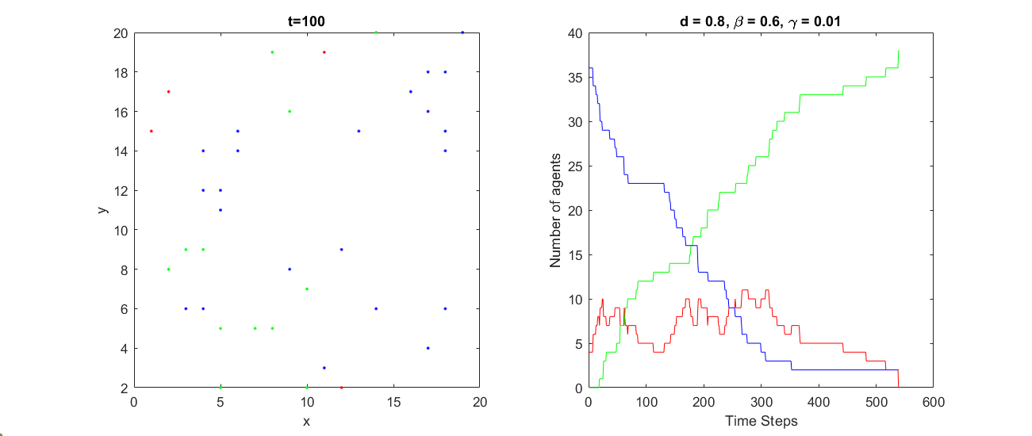
Modelling disease spreading on a 20x20-lattice

Slide 5
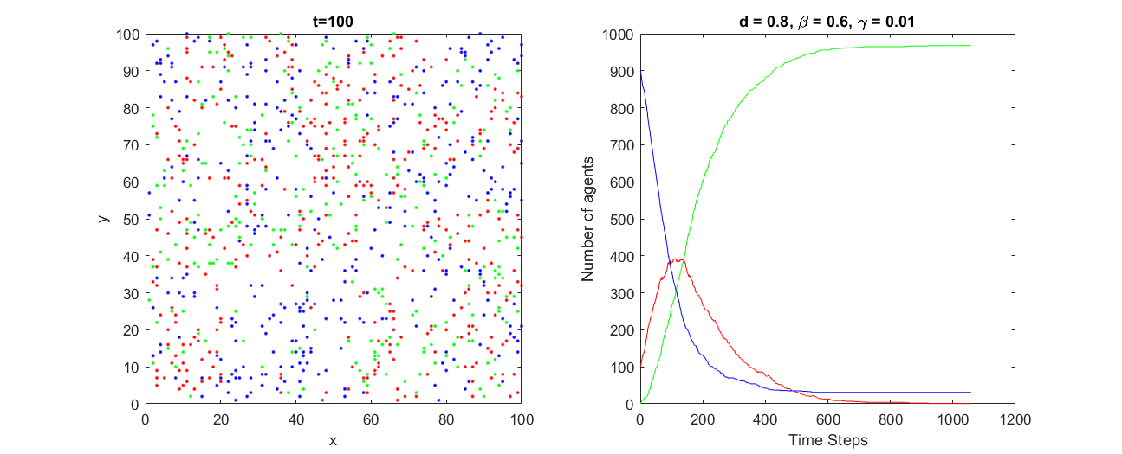
Modelling disease spreading on a 100x100-lattice

Slide 6
Exercise 2
Show that the model contains two regimes: there are parameter values for which the disease spreads to a large proportion of the population and values for which it doesn’t.
Population-wide disease spreading
Limited disease spreading

Slide 7
Population-wide disease spreading
Increase β: increases the probability of infecting all susceptibles at its current site
Decrease γ: decreases the probability of recovering from the disease, so each infected will stay infected (and therefore contagious) for longer
Parameters used:
N=1000
100x100-lattice
d=0.8; β=0.8; γ=0.01

Slide 8
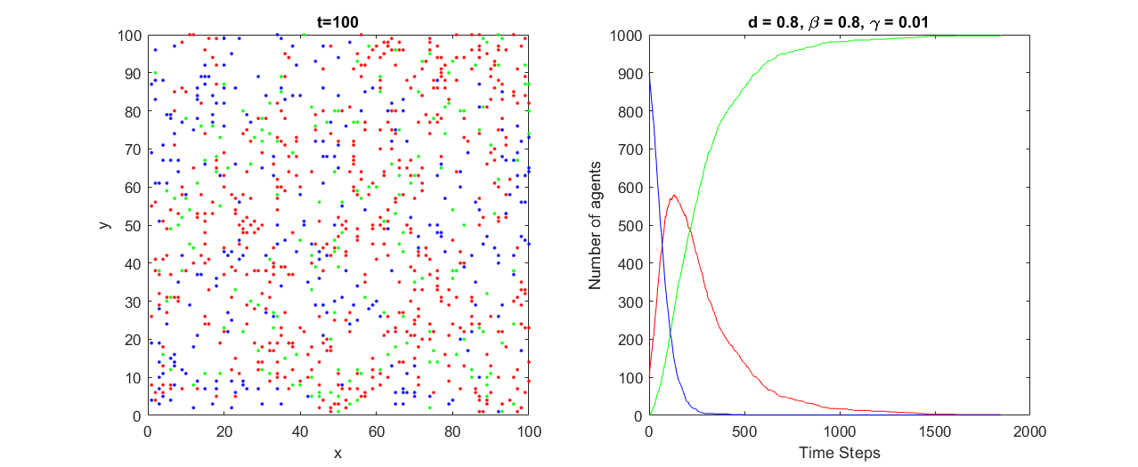
Population-wide disease spreading

Slide 9
Limited disease spreading
Decrease β: decreases the probability of infecting all susceptibles at its current site
Increase γ: increases the probability of recovering from the disease, so each infected will stay infected (and therefore contagious) for a shorter period of time
Parameters used:
N=1000
100x100-lattice
d=0.8; β=0.4; γ=0.1

Slide 10
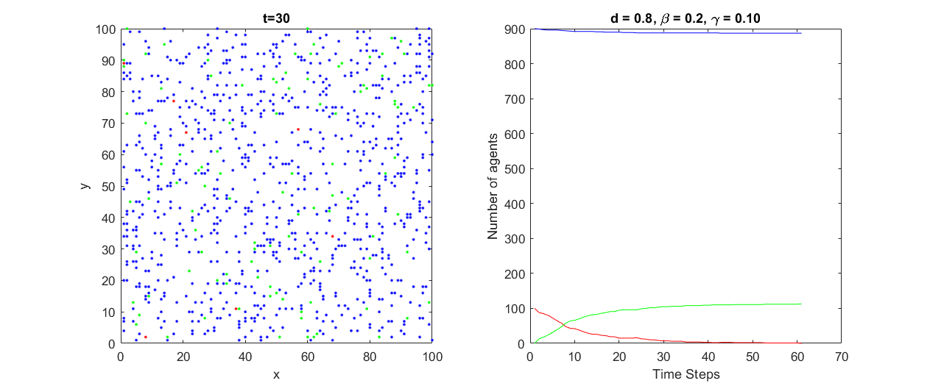
Limited disease spreading

Slide 11
Exercise 3
Show that the epidemic threshold depends on not just the ratio k(β/γ) but on the parameters themselves. Fixing a value for β, run the model for each of several values of γ and record the final proportion of recovered agents.
Parameters used:
N=1000;
100x100-lattice
100 different values of gamma for each case (with similar spacing)
10 runs for each combination were used for averaging

Slide 12
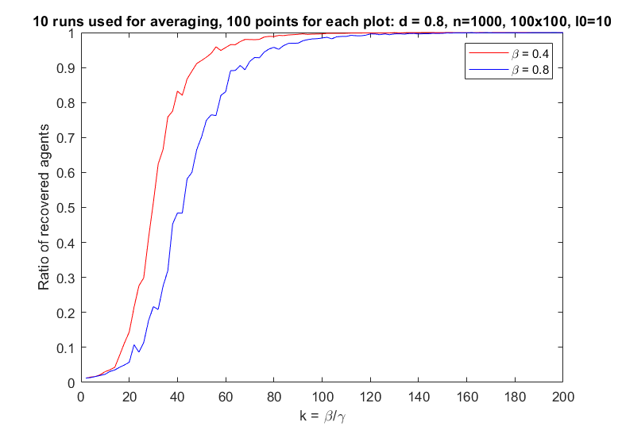
Plot comparing the two data sets
Threshold for population-wide disease spreading
Threshold for limited disease spreading

Slide 13
Exercise 4
Repeat the previous process for enough values of β that you can determine the important features of the phase diagram.
Parameters used:
N=1000
100x100-lattice
40 different values of β and 40 different values of γ for each β (1600 points)
5 runs for each combination were used for averaging

Slide 14
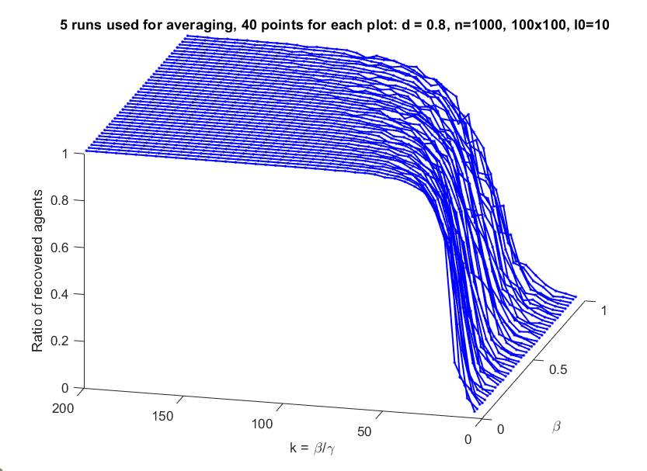
3D Model

Slide 15
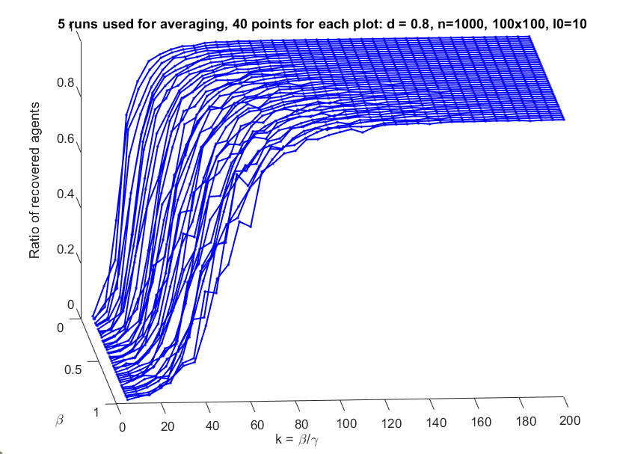
3D Model

Slide 16
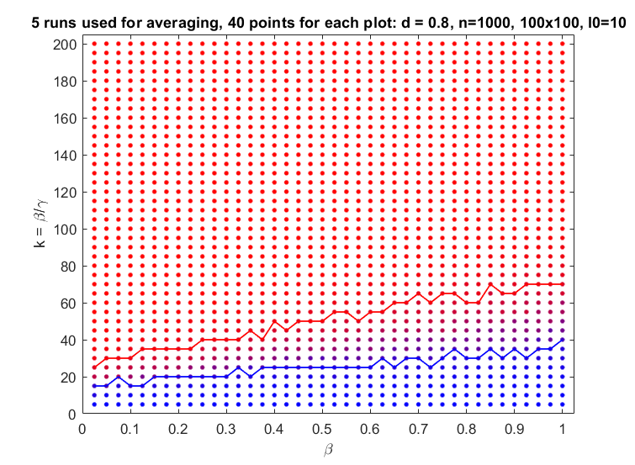
2D Projection on β-k plane

Slide 17
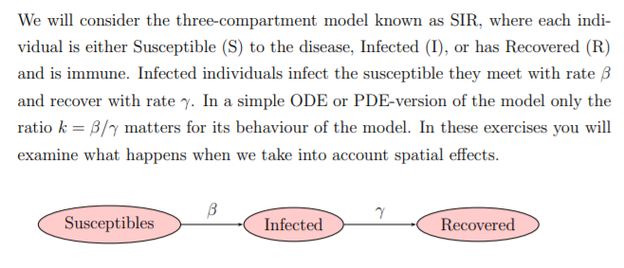
ODE version of the SIR model

Slide 18
Discussion
Increasing k increases the ratio of recovered agents
For higher values of β, the ratio of recovered agents increases slower
For same values of k, different values of β will have different values of γ (proportional)
High β increases tendency to population-wide spreading, but a high γ has a opposite effect
It appears that the recovery speed is more effective in delaying the spreading.
For lower values of β, the ratio of recovered agents increases rapidly
Low β decreases tendency to population-wide spreading, but a low γ has a opposite effect
Even if it is less probable to infect every time step, if the agents stay infected for longer, the infection will eventually spread
In conclusion, it is not true that the model depends only on k= β/ γ. It also depends on the parameters.

